Slide 1

TraDWin: An interactive Digital Twin for City Traffic
Shreyansh Yadav, 19074018
Under the guidance of
Dr. Vignesh Sivaraman
Department of Computer Science and Engineering,
Indian Institute of Technology (BHU), Varanasi
May 24, 2024
May 24, 2024
TraDWin: An interactive Digital Twin for City Traffic

Slide 2
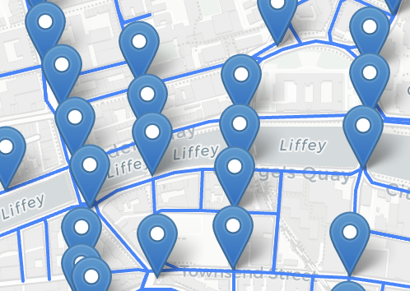
Problem: Traffic management and planning
For given graph, how to do?
Prediction
Imputation
Reassignment on modification
Why needed?
Data-driven insights
Better planning
Sustainable development
Fig. 1 Dublin road network with sensors
May 24, 2024
TraDWin: An interactive Digital Twin for City Traffic

Slide 3
Challenges and issues with existing methods
Simulation as de-facto way
Need OD pairs
Existing methods
Only time-series analysis.
No graph modifications
Ignore other exogenous factors
Weather, road conditions, etc.
Data collection
Multiple scenarios
May 24, 2024
TraDWin: An interactive Digital Twin for City Traffic

Slide 4
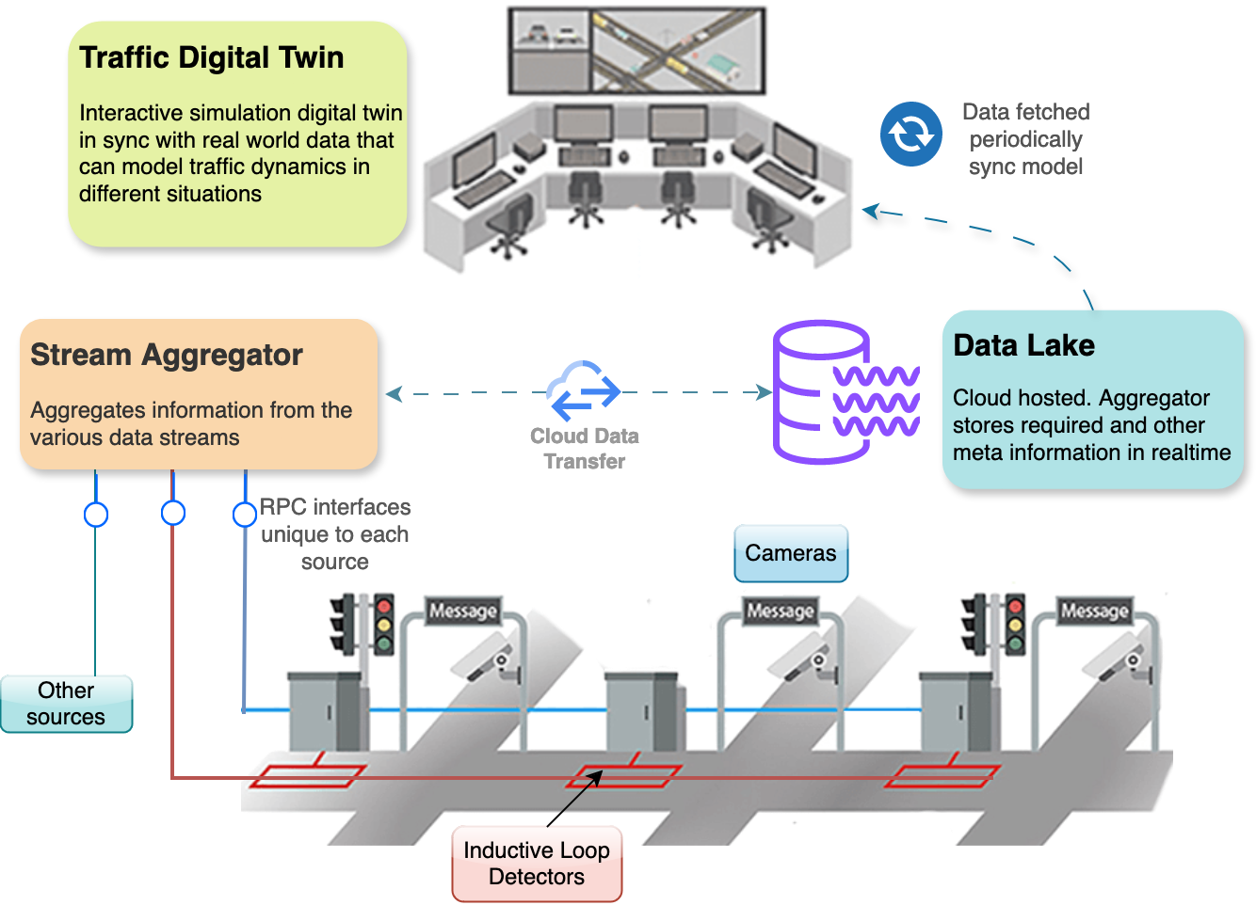
TraDWin: Traffic Digital Twin as Solution
Fig. 2 Traffic Digital Twin overall schematic
May 24, 2024
TraDWin: An interactive Digital Twin for City Traffic

Slide 5
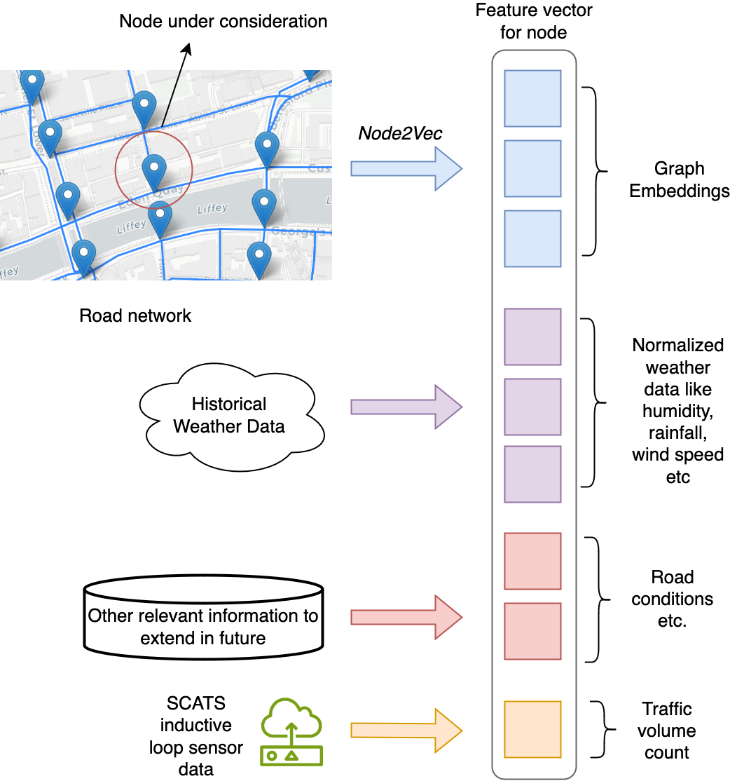
Model Architecture: Input features
Fig. 3 Traffic Digital Twin overall schematic
May 24, 2024
TraDWin: An interactive Digital Twin for City Traffic

Slide 6
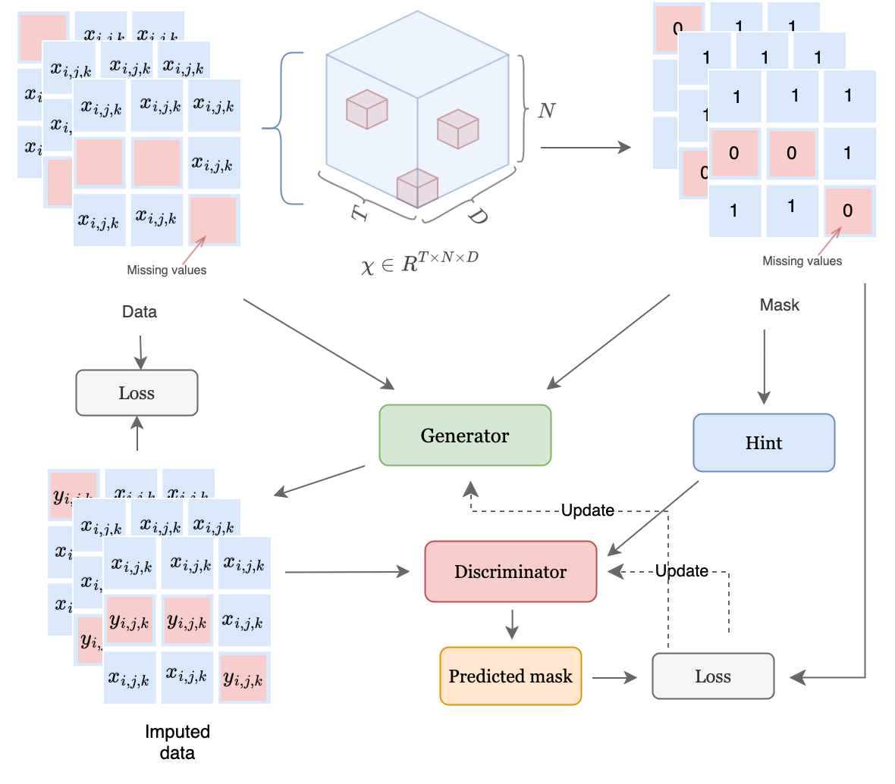
Model Architecture
Fig. 4 TraDWin model details
May 24, 2024
TraDWin: An interactive Digital Twin for City Traffic

Slide 7
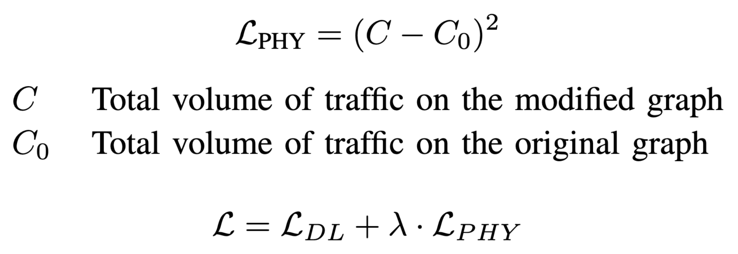
Model Architecture: Conversation loss
Reassignment on modification
MNAR imputation
Problem: Non-conservation on reassignment.
Solution: Biasing using additional conservation loss.
May 24, 2024
TraDWin: An interactive Digital Twin for City Traffic

Slide 8
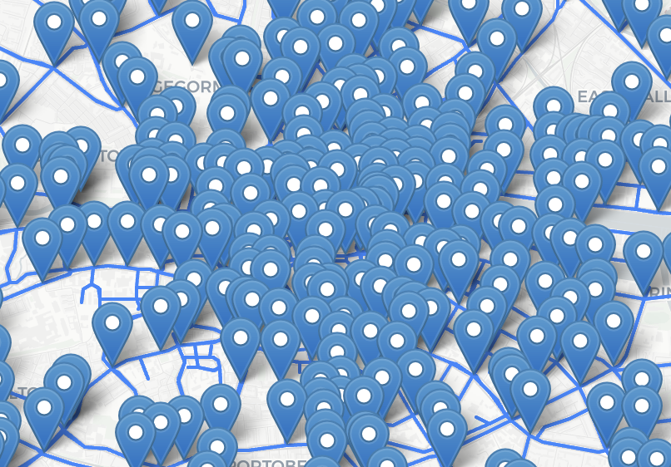
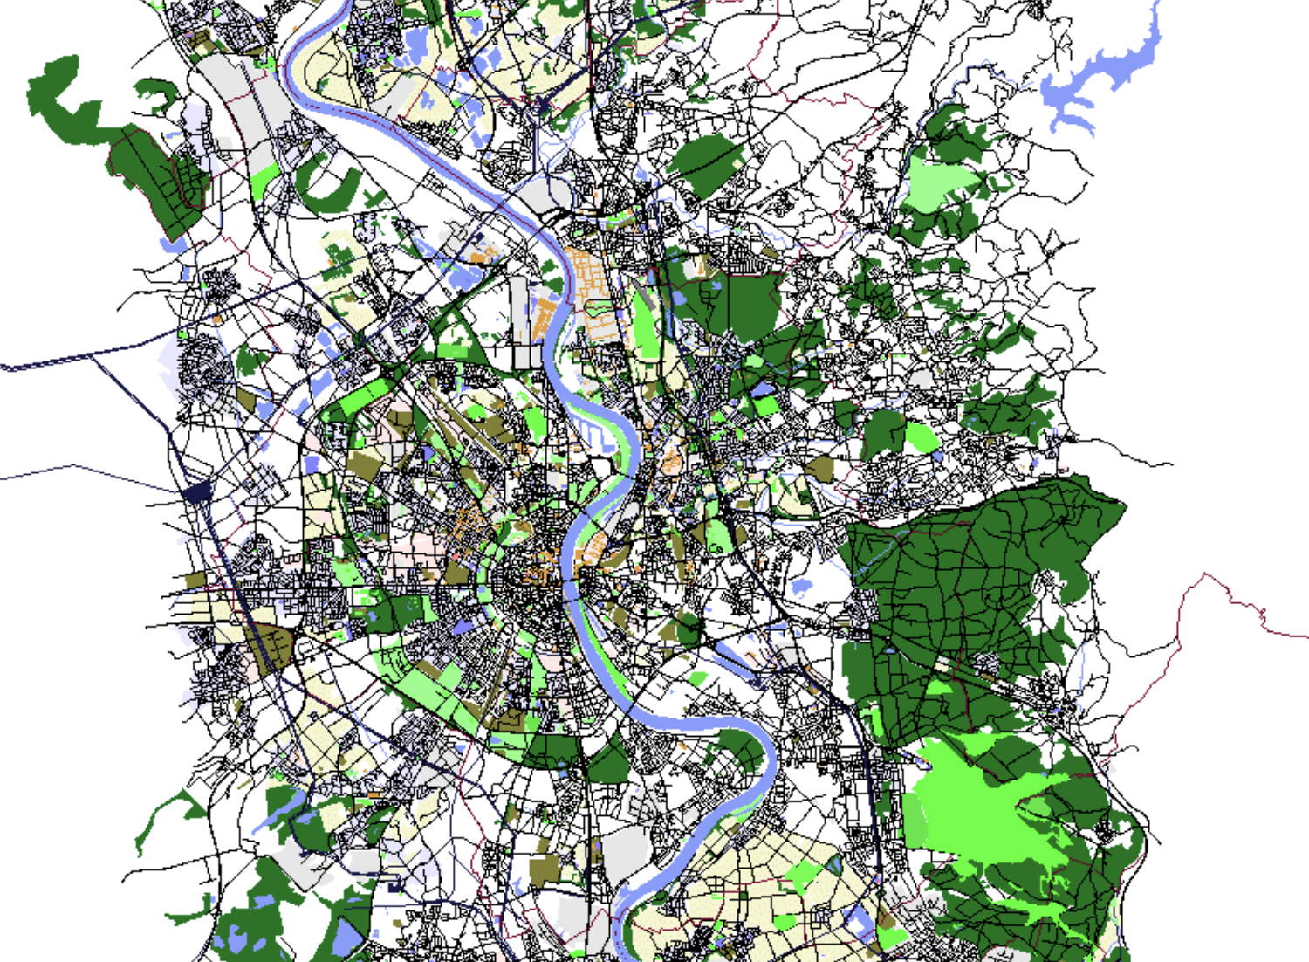
Datasets
Dublin SCATS dataset:
3 months (October 1, 2023 to December 31, 2023).
825 sensors
Frequency 1 hour.
TAPASCologne Simulation Scenario:
SUMO simulation scenario
Fig. 5 Dublin city with SCATS sensors
Fig. 6 SUMO TAPASCologne Scenario
May 24, 2024
TraDWin: An interactive Digital Twin for City Traffic

Slide 9
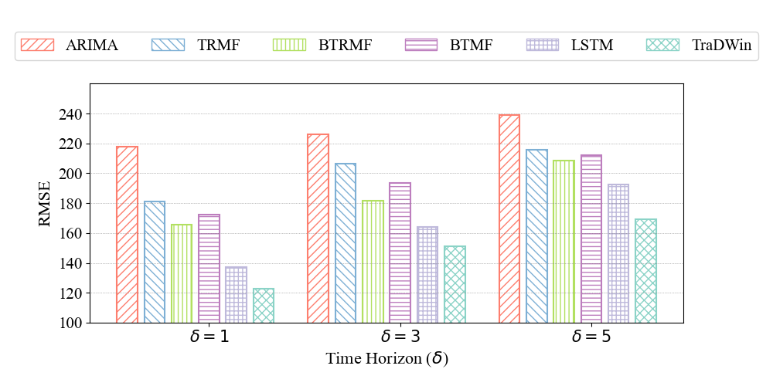
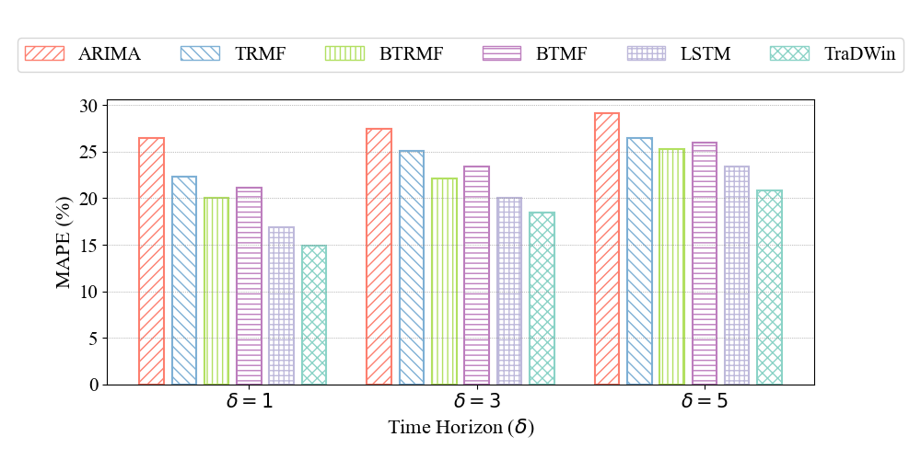
Results: Prediction
Fig. 7 Performance metrics on prediction task
May 24, 2024
May 24, 2024
TraDWin: An interactive Digital Twin for City Traffic

Slide 10
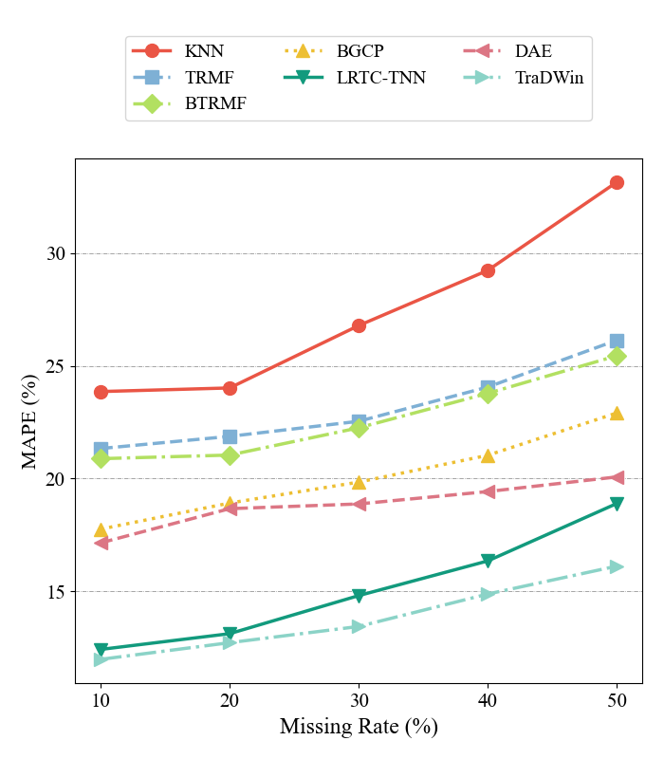
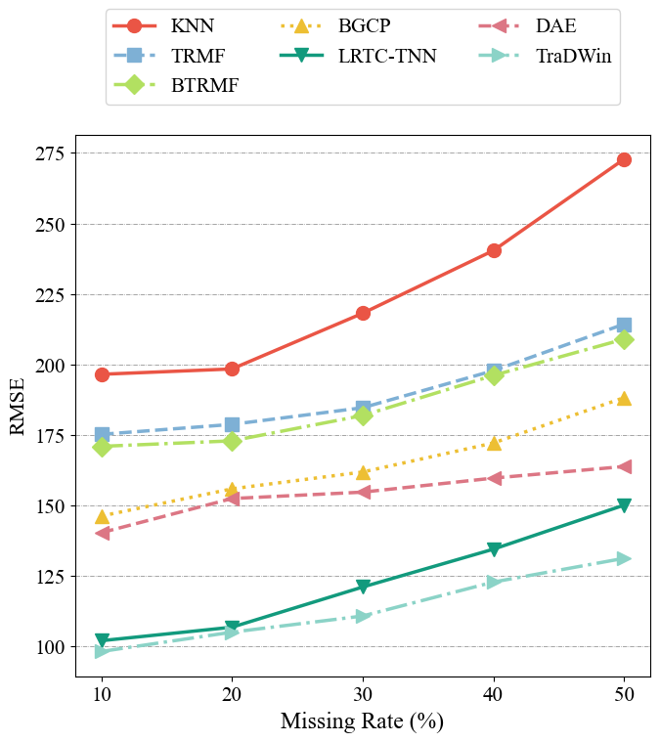
Results: Imputation
Fig. 8 Performance metrics on imputation task
May 24, 2024
May 24, 2024
TraDWin: An interactive Digital Twin for City Traffic

Slide 11
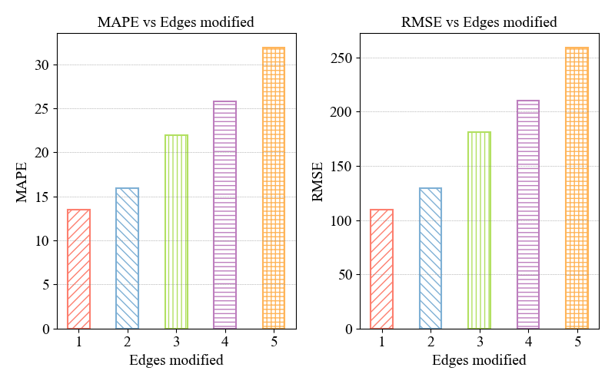
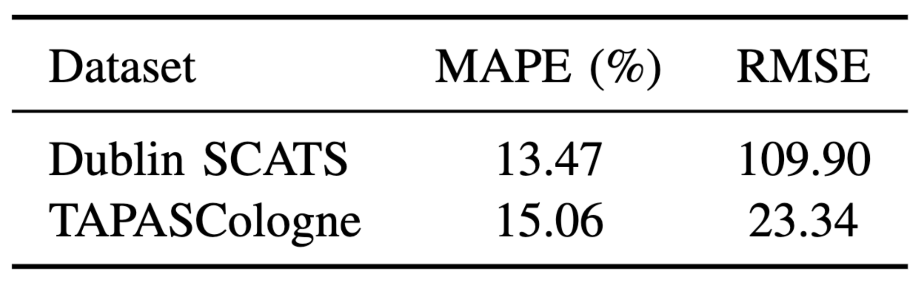
Results: Re-Assignment on edge modification
Fig. 9 Performance metrics on re-assignment task
Table 1 Re-assignment metrics on different datasets
May 24, 2024
May 24, 2024
TraDWin: An interactive Digital Twin for City Traffic

Slide 12
Conclusion and Future work
Contributions:
Digital Twin framework
Model
Validation
Real-world use cases
Future Work:
Multi-task learning (MTL)
May 24, 2024
May 24, 2024
TraDWin: An interactive Digital Twin for City Traffic

